Slide 1
Aciurina

Slide 2
Stacks - denovo
96 initial samples
Ran with 4 different parameters
Parameters chosen: m5 M3 n3
Filtered using SNPfiltR
hard filter to minimum depth of 5, and minimum genotype quality of 30
Filter by the max depth cutoff of 100
3 samples (opaca) above a 0.8 missing data not removed for now
Other SNPfiltR cutoffs done
Processed variant: from 26023 to 22057
96 final samples

Slide 3
VCF tools
Variant missingness:
Missingness on a per-site basis. This is a measure of how many individuals lack a genotype at a call site.
Typically, missingness of 75-95% is used.

Slide 4
VCF tools
Mean depth per site averaged across all individuals.
- the number of reads that have mapped to this position (coverage)
- the more reads that cover a site, the higher confidence our basecall is.

Slide 5
VCF tools
Proportion of missing data per individual:
Missingness on a per-individual basis = proportion of missing data per individual

Slide 6
VCF tools
Mean depth per individual

Slide 7
VCF tools
Minor allele frequency

Slide 8
Missingness and depth per population

Slide 9
Missingness per indivicual

Slide 10
all

Slide 11
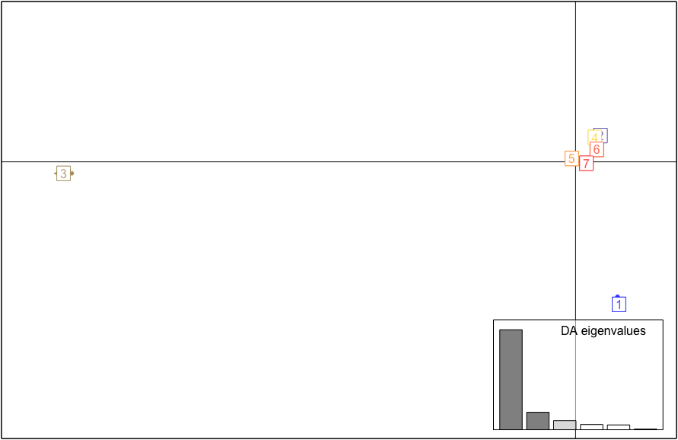
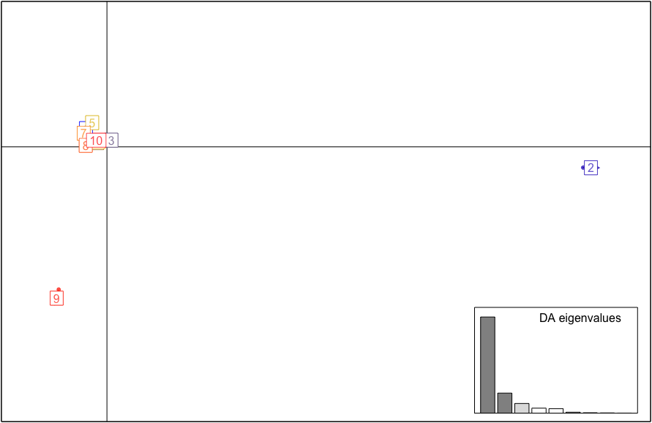
DAPC
1 | Marshmallow
2 | Opaca
3 | Notata
4 | NM Cotton
5 | Utah (S & G) + Reno (S & SH)
6 | CO, UT, MT Cotton
7 | NM + CO smooths
8 | Moab G
9 | Reno
10 | CO F
1 | Reno
2 | NM smooths
3 | Opaca
4 | Utah (S & G) + Reno (S & SH)
5 | Notata
6 | Marshmallow
7 | F & C

Slide 12
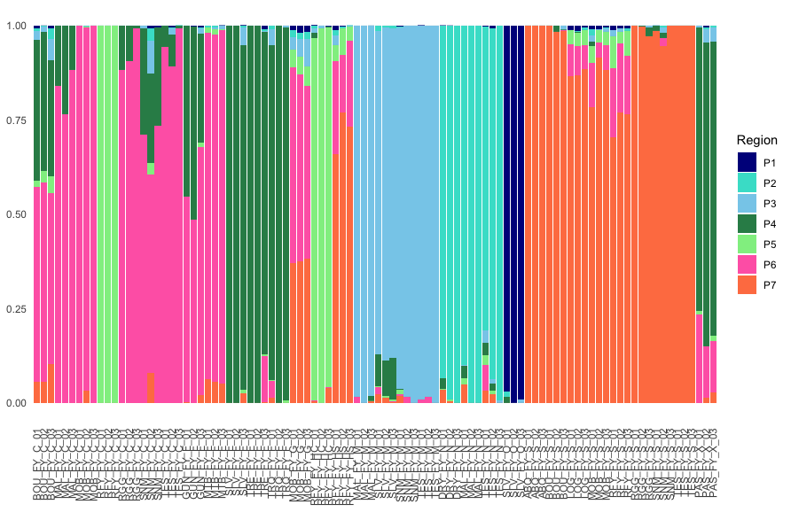
P7

Slide 13
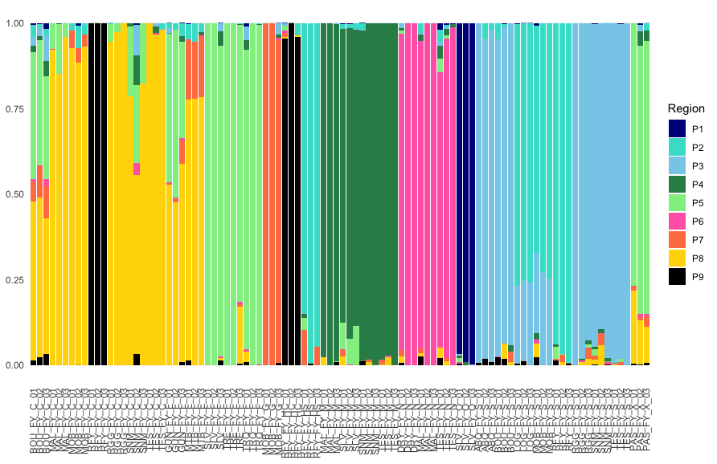
P9

Slide 14
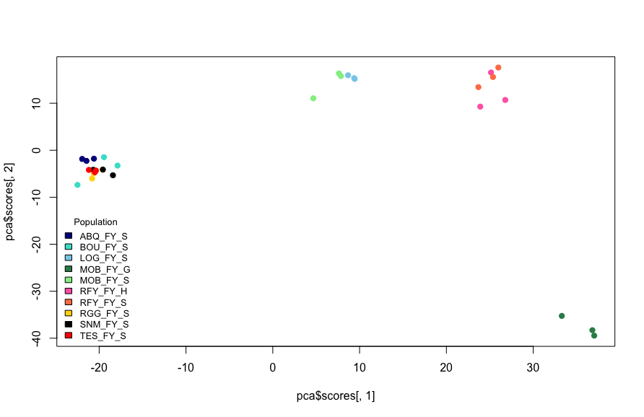
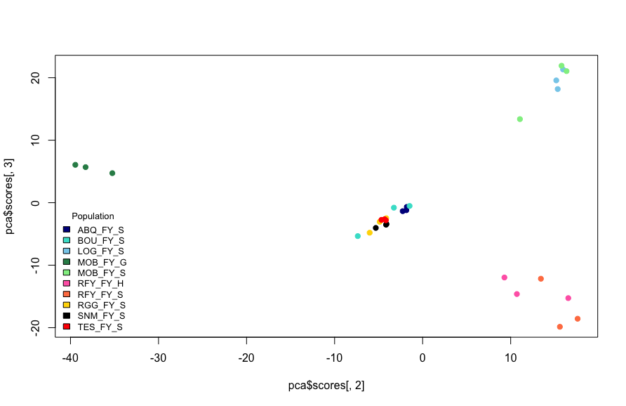
Smooth
Processed variant: 52170
- Smooth - Goober

Slide 15
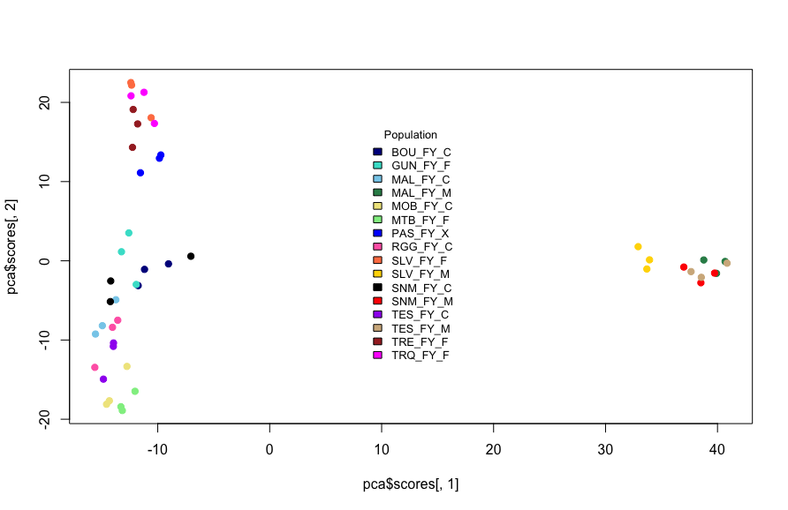
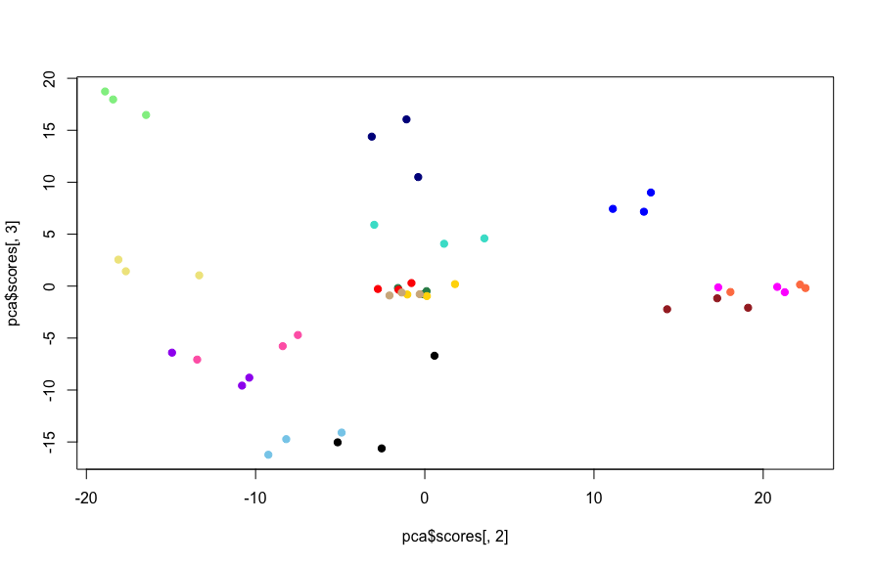
MFC
Processed variant: 41628
- Marshmallow - Finnial - Cotton

Slide 16
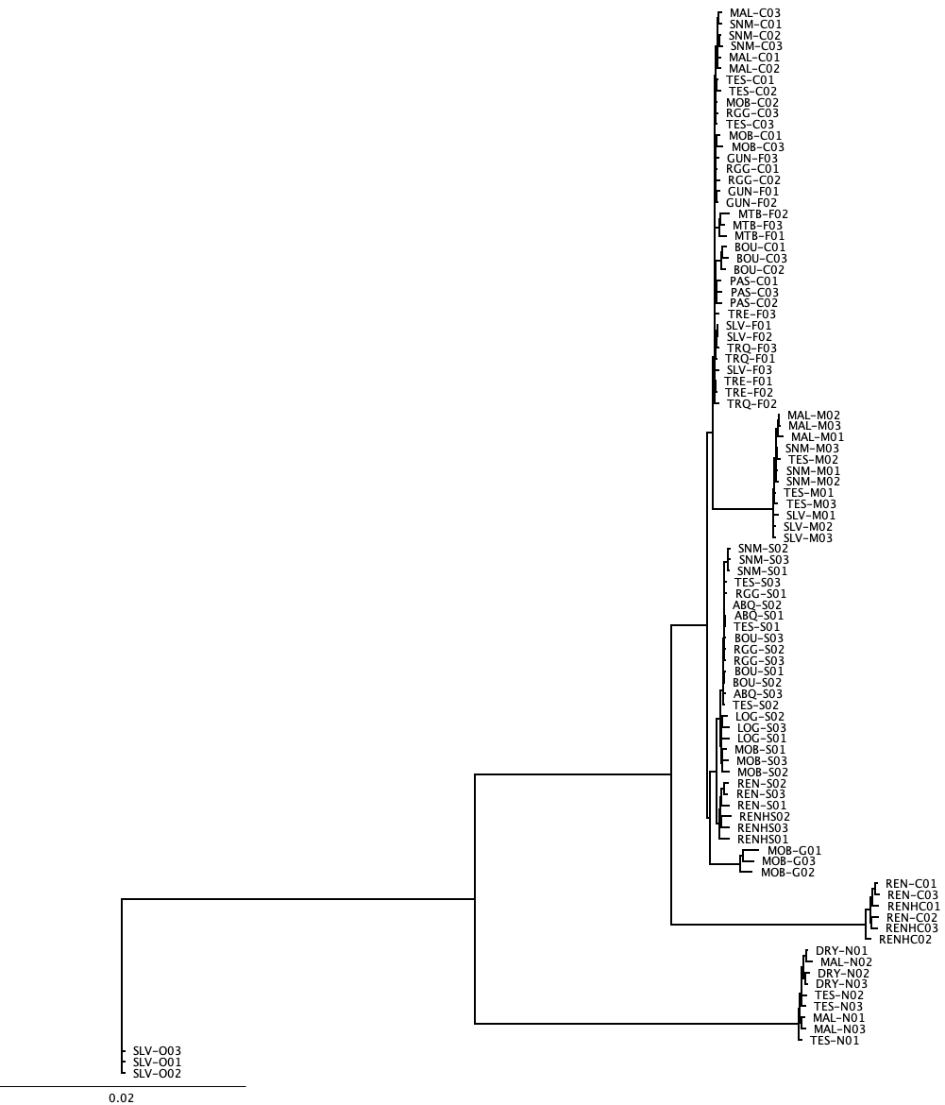
Fly
cotton/finial
IQTree
TVMe+ASC+R3 (AIC) and 1000 bootstrap 1000 alrt
marshmallow
smooth
goober
cotton
notata
opaca

Slide 17
Rabbitbrush

Slide 18
Initial denovo
198 initial samples
Ran with 4 different parameters
Only one finished running: m7 M3 n3
Variant count: 534532

Slide 19
VCF tools Stacks
Variant missingness:
Missingness on a per-site basis. This is a measure of how many individuals lack a genotype at a call site.
Typically, missingness of 75-95% is used.

Slide 20
VCF tools Stacks
Mean depth per site averaged across all individuals. The number of reads that have mapped to this position (coverage)

Slide 21
VCF tools Stacks
Proportion of missing data per individual:
Missingness on a per-individual basis = proportion of missing data per individual

Slide 22
VCF tools Stack
Mean depth per individual

Slide 23
VCF tools Stacks
Minor allele frequency

Slide 27
.50 cutoff missing data in each sample

Slide 28
Ran using 3 different methods
Stacks using 6 different parameters – reduced sample set
Stacks using reference based using Erigeron canadensis
Ipyrad

Slide 29
Stacks using 6 different parameters – reduced sample set
198 initial samples
Reduced dataset (~5 samples per phenotype) = 27 initial samples (S, F, C, M, N)
SNPfilrtR
hard filter to minimum depth of 5, minimum genotype quality of 30
max depth cutoff of 100
missing data in each sample = .75
variant count: 203993
variant count after filtering: 11822

Slide 30
VCF tools Stacks using 6 different parameters
Variant missingness:
Missingness on a per-site basis. This is a measure of how many individuals lack a genotype at a call site.
Typically, missingness of 75-95% is used.

Slide 31
VCF tools Stacks using 6 different parameters
Mean depth per site averaged across all individuals.
- the number of reads that have mapped to this position (coverage)
- the more reads that cover a site, the higher confidence our basecall is.

Slide 32
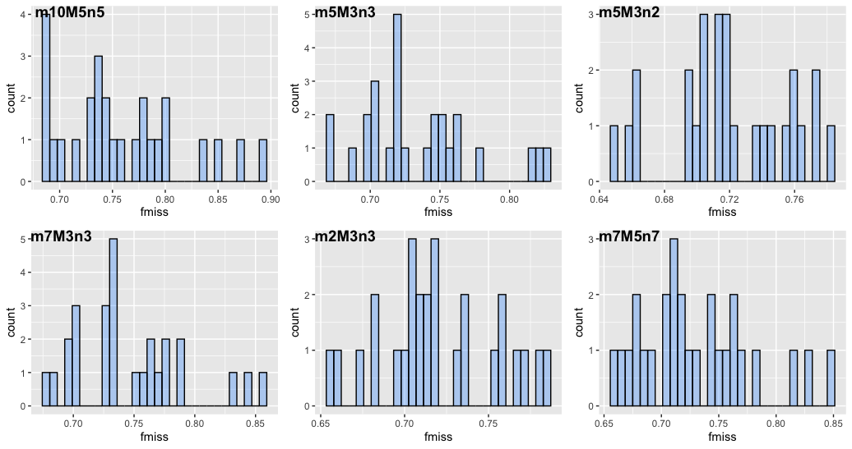
VCF tools Stacks using 6 different parameters
Proportion of missing data per individual:
Missingness on a per-individual basis = proportion of missing data per individual

Slide 33
VCF tools Stacks using 6 different parameters
Mean depth per individual

Slide 34
VCF tools Stacks using 6 different parameters
Minor allele frequency

Slide 35
Stacks – small dataset m7 – M5 – n7

Slide 36
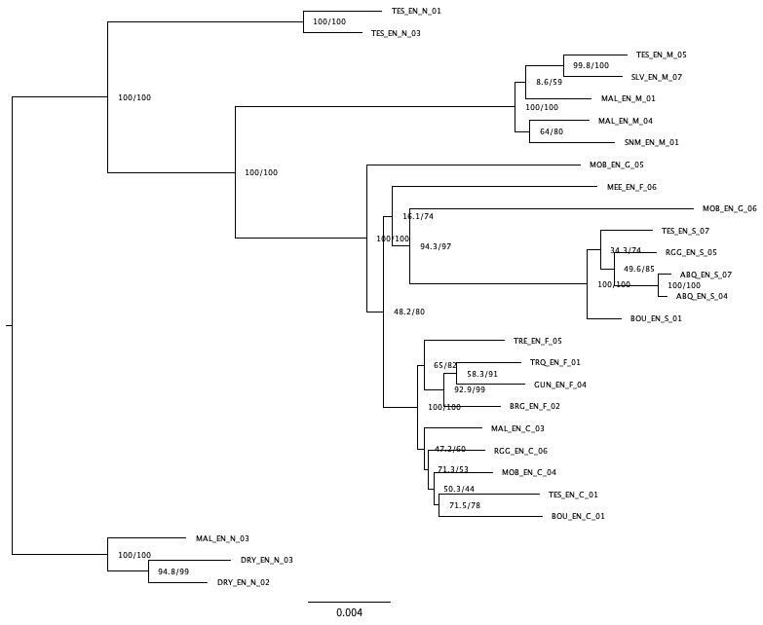
Stacks – small dataset m7 – M5 – n7
notata
marshmallow
goober
finial
goober
smooth
finial
cotton
notata

Slide 37
Reference based and Ipyrad

Slide 38
Reference based and Ipyrad
198 samples
Ipyrad
variant count for first run 963177
Still processing
Stacks reference based
Erigeron canadensis genome
variant count: 31163
variant count after filtering: 6852
131 samples after filtering
hard filter to minimum depth of 5, and minimum genotype quality of 30
max depth cutoff of 100
missing data in each sample = .70 (30%)

Slide 39
Reference based & ipyrad vcf tools
Variant missingness:
Missingness on a per-site basis. This is a measure of how many individuals lack a genotype at a call site.
Typically, missingness of 75-95% is used.
Mean depth:
Mean depth per site averaged across all individuals.
The number of reads that have mapped to this position (coverage). The more reads that cover a site, the higher confidence our base call is.

Slide 40
Reference based & ipyrad vcf tools
Proportion of missing data per individual
Missingness on a per-individual basis = proportion of missing data per individual
Mean depth per individual

Slide 41
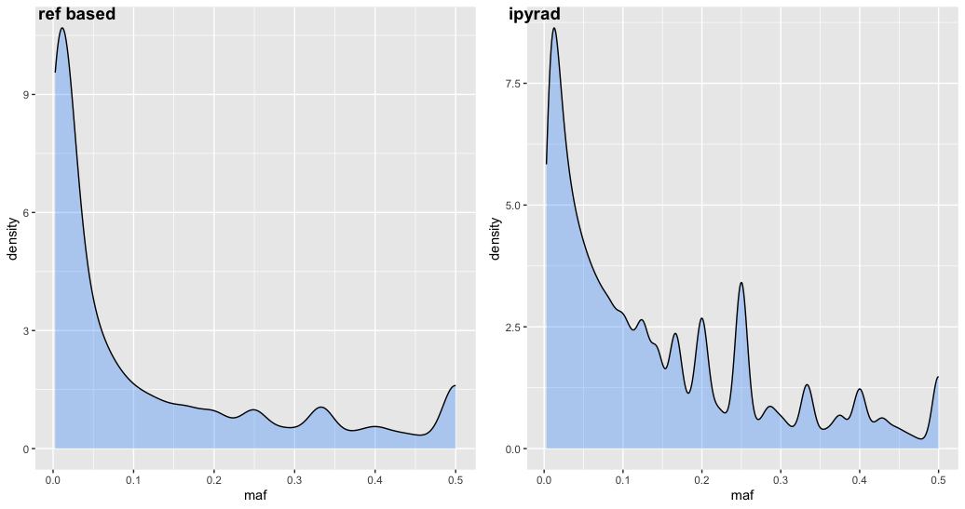
Reference based & ipyrad vcf tools
Minor allele frequency

Slide 42
Reference based

Slide 43
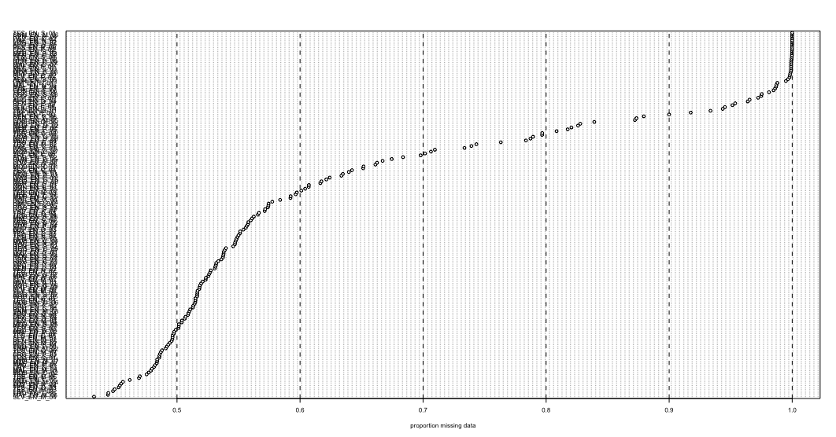

Slide 44
PCA using reference-based assembly – PC1&2

Slide 45
PCA using reference based assembly – PC2&3
PC3&1

Slide 47
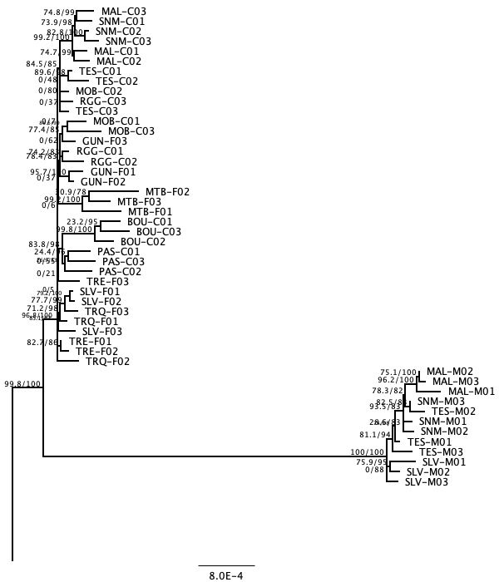
Fly
cotton/finial
marshmallow

Slide 48
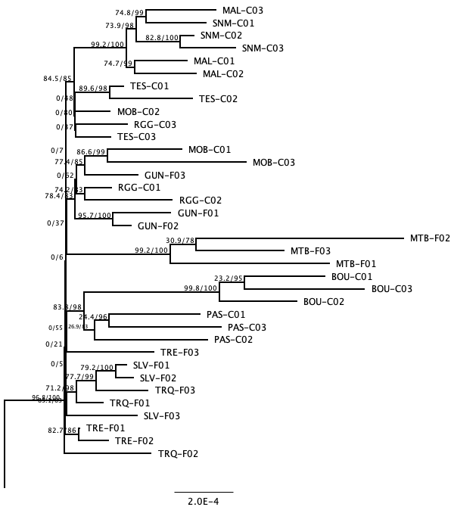
Fly
cotton/finial

Slide 49
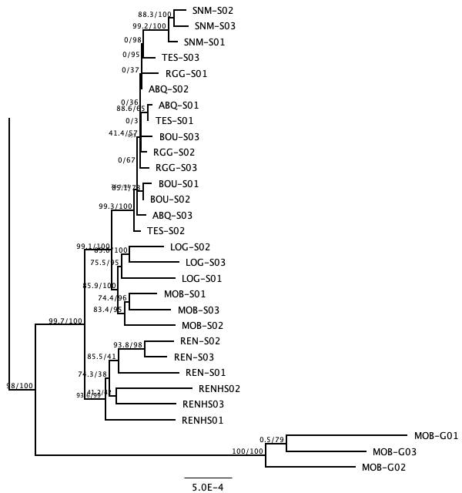
Fly
smooth
goober

